Slide 1
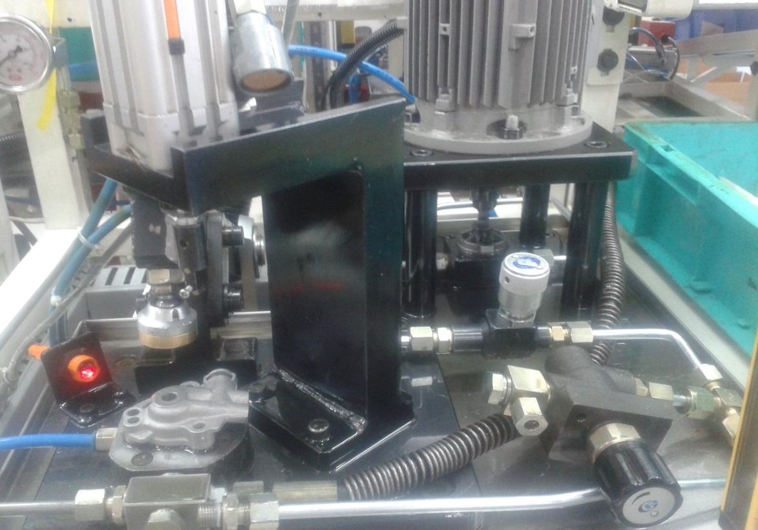
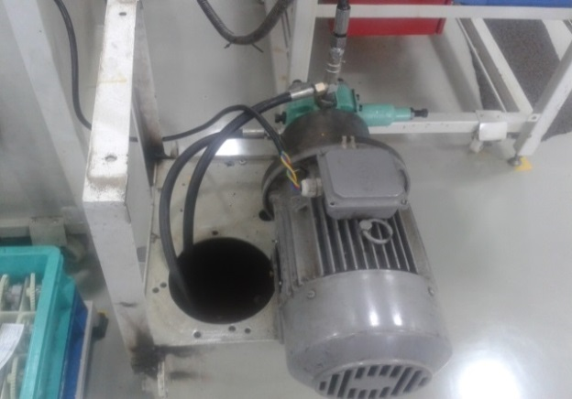
P15
TPM CIRCLE NO :- 3
ACTIVITY
KK
QM
PM
JH
SHE
OT
DM
E&T
KAIZEN IDEA SHEET
TPM CIRCLE NAME : P15 TEAM
LOSS NO. / STEP
DEPT :- Assembly
RESULT AREA
P
Q
DEF :- A
C
D
S
M
CELL :-A386
CELL NAME:- Oil Pump
MACHINE / STAGE :- A386 Assembly Line
OPERATION :- PRV testing stage.
KAIZEN THEME : To eliminate breakdown of PRV testing m/c.
IDEA :- Maintain constant pressure.
COUNTERMEASURE:- To maintain constant pressure external motor provided which will avoid air entrapment in the piping.
BENCHMARK
45mins
WIDELY/DEEPLY:-
TARGET
0 mins.
KAIZEN START
20.06.2016
PROBLEM / PRESENT STATUS :- High Air entrapment breakdown time of A386 machine 120 ~ 200 min / month.
KAIZEN FINISH
10.07.2016
TEAM MEMBERS :-
Bhavesh Pednekar, Ajay Bhor,
Janardan Sathe, Sunil Kinkar
BENEFITS :-
Reduce breakdowm mins.
Reduce rejection.
KAIZEN SUSTENANCE
BEFORE
AFTER
WHAT TO DO: NA
HOW TO DO : NA
FREQUENCY : NA.
WHY - WHY ANALYSIS :-
Why1: High Air entrapment breakdown time
Why 2: Air flow through piping at the time of new cycle
Why 3: Oil remaining in pipes get drain while changing parts for new cycle
Why 4: Drop in oil pressure
RESULT :-
Result Monitoring
COST INCURRED FOR MAKING KAIZEN
MATERIAL COST
IN RS
LABOUR COST
IN RS
TOTAL COST
IN RS
ROOT CAUSE :- Drop in oil pressure
------------
-------
---------
SCOPE & PLAN FOR HORIZONTAL DEPLOYMENT
REGISTRATION NO. & DATE: 10.07.16
SR.
NO.
CELL
TARGET
RESPONSIBILITY
STATUS
REGISTERED BY :- Bhavesh Pednekar
---
NA
-------
------
------
MANAGER’S SIGN :- Janardan Sathe

